Slide 1
Using financial modeling to explain the benefits of estate planning techniques and how to reduce or eliminate the grantor’s obligation to pay the income taxes on the grantor trust’s income (the “burn”).
Presented by Jerry Hesch
Yale Study Group
YCISG Zoom Meeting
April 1, 2024

Slide 2
Jerome M. Hesch
Director, 50th Annual Notre Dame Tax & Estate Planning Institute
September 25-27, 2024
Meltzer, Lippe, Goldstein & Breitstone, LLP
Boca Raton, Florida
jhesch@meltzerlippe.com
Jhesch62644@gmail.com

Slide 3
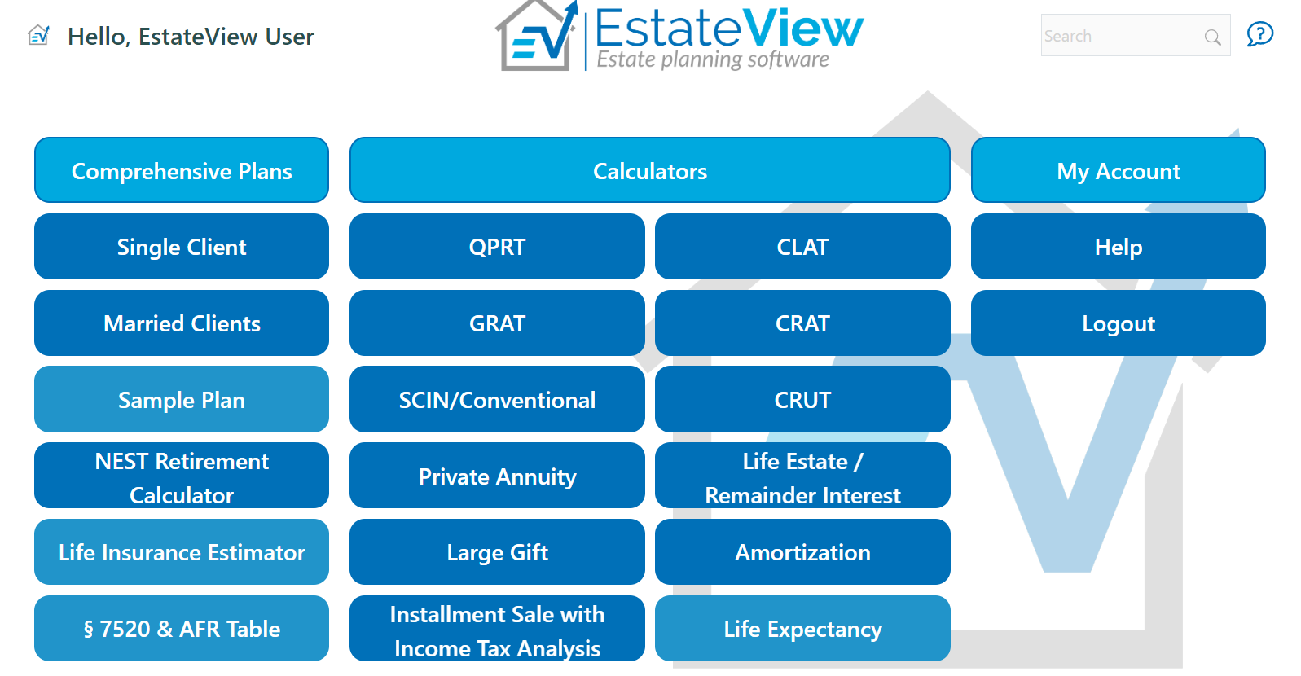
Illustrations Provided Using EstateView Planning Software
At the end are instructions allowing one to access EstateView free of charge while it is still in the development stage

Slide 4
Introduction
When discussing estate planning strategies with clients, it is imperative to discuss the benefits of planning versus not planning. Sometimes the benefits can be showcased with an easy example or two, as when discussing the use of the lifetime exemption to make taxable gifts with no gift taxes.
In addition to explaining the gift and estate tax benefits of a proposed planning technique, another objective of financial modeling is to communicate these tax benefits in an understandable manner.
The first example covered is a gift of an income-producing asset to a grantor trust. Even a gift to a grantor trust can be confusing because the grantor has to pay the income taxes on the grantor trust’s income.

Slide 5
The Four Factors Designed To Shift Value To A Trust That Is Not Exposed To The Estate Tax Without Having to Use The Gift Or Estate Exemptions
Valuation discounts.
Financial leverage.
Freeze current value.
Using grantor trusts (the “burn”).
Secondary objective: Step-up in basis at death.
Example: Value of Senior’s asset is $1,000,000. Discounted value is $800,000. Senior sells the discounted asset to a grantor trust for an $800,000 promissory note at 4.0% annual interest, or $32,000 each year. The $1,000,000 asset generates $60,000 of annual income. After paying the $32,000 of note interest, the grantor trust nets $28,000. At a 40% income tax rate, the income taxes on $60,000 are $24,000. Because the grantor has to pay the income taxes on the $60,000 of income, the grantor depletes his retained assets by $24,000. Therefore, the aggregate wealth shift is $52,000 ($28,000 net in trust + $24,000 depletion of grantor’s remaining assets) each year.
If the sale was to a non-grantor trust, the trust would receive $60,000 of income, deduct its $32,000 interest payment, paid $11,200 of income taxes on $28,000 of income and would netted after its interest payment and income tax payment only $16,800. Instead, as a grantor trust, the trust netted $28,000.

Slide 6
Financial Modeling Not Only Explains How The Gift In Trust Works In An Understandable Manner, But Also can be used To Have The Client Actively Participate In the Design of A Proposed Strategy.
Clients want to know “the hard numbers” in order to gauge whether moving forward with a particular strategy makes financial and emotional sense.
Imagine explaining how the four factors that shift wealth work together using the installment sale to a grantor trust without having a spreadsheet illustrating the numbers on a page in front of them. It can be difficult and confusing, but when there are numbers on a page, strategies often come alive.

Slide 7
Modeling Strategies Not Only Provide Tangible Numerical Data For Clients.
They also Provide Insights Into How The Proposed Strategies Work.
Financial Modeling Highlights Those Insights And Provides A Vehicle To Help Their Clients Make Better Decisions Around Their Planning, Ones That Align More Closely With Their Personal Needs And Their Financial Goals.

Slide 8
An often overlooked concern is the financial impact on the grantor’s retained assets of grantor trust treatment for income tax purposes. As time goes by, the grantor is often concerned with the obligation to continue to pay the income taxes on the grantor trust’s income.
When we illustrate the gift to a grantor trust, and later the installment sale to a grantor trust, you need to consider “how to minimize the impact of the grantor having to pay the income taxes on the grantor trust’s income.”
As the financial illustrations demonstrate, the financial impact of the “burn” compounds and increases over time. .
Using financial modeling allows one to address alternatives to consider that reduce the burn.
A list of those alternatives is provided later in these materials.

Slide 9
Illustrating the “Burn”
Assume the following facts:
Senior, age 70 and single, currently has $20,000,000 of income producing investment assets. This year Senior spent $500,000 of his investment income for personal living expenses in addition to spending the income from social security and his pension plan. It is estimated that his person living expenses will increase 3% each year.
Assume an effective 30% Federal and state income tax rate for a combination of capital gains and ordinary income.
Senior wants to make a gift to a trust for the benefit of his children and asks how much he can give away given the above assumptions. The gift tax exemption for 2024 is $13,610,000.
For purposes of the illustrations, assume a conservative rate of return of 5% on Senior’s investment assets.
Financial modeling allows the planner to consider the depletion of the grantor’s retained assets by: (1) the grantor paying the income taxes on the grantor trust’s income and (2) the amounts the grantor spends on personal living expenses.
Each of the following gift examples is designed to illustrate the point in time when these two wealth depletion factors exhaust all of the grantor’s retained assets while the grantor is still alive. In the first example, the grantor gifts $10,000,000 and retains $10,000,000. The exhaustion of Senior’s retained assets occurs at age 86. Knowing this, one can gift less of the $20,000,000 and retain more of the $20,000,000

Slide 10
Illustrating the “Burn” – Scenario One
Gift of $10,000,000
In the first year, Senior received $500,000 of income from the retained $10,000,000 of assets, and paid $150,000 of taxes on that income. After paying $150,000 of taxes on the Trust’s income and spending $500,000 on personal consumption, Senior had to invade $300,000 of his retained $10,000,000.
The payment of the income taxes by Senior on his income and the Trust’s income (the “burn”) and Senior’s personal consumption totals $800,000, and that amount exceeds Senior’s $500,000 of income from his retained investments.
If Senior survives past the age of 86, he will run out of assets. The probability of survival column in the spreadsheet shows that the probability of Senior age 70, surviving to age 86 is 44%.

Slide 11
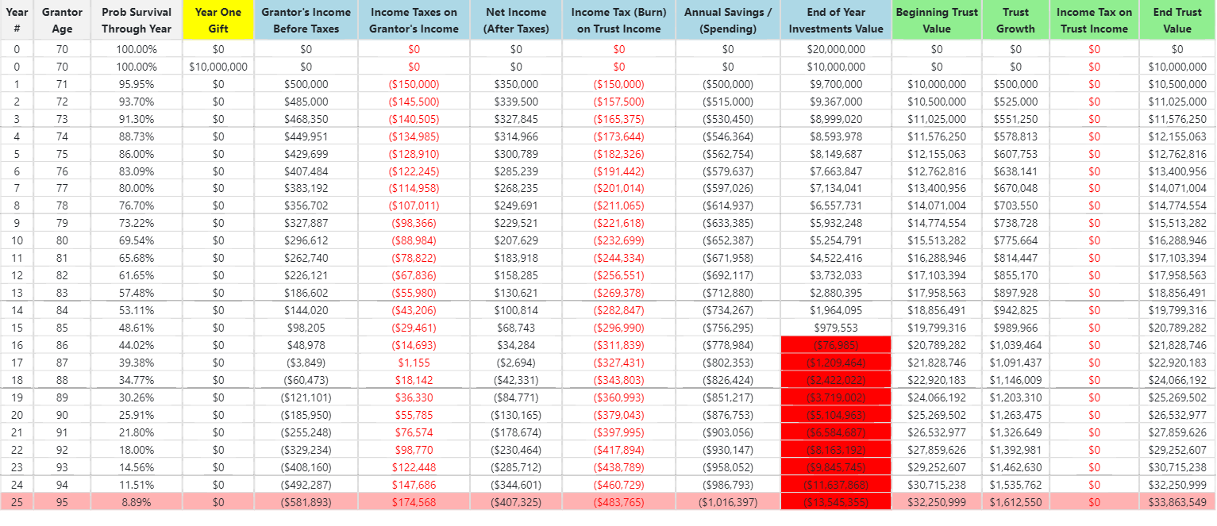
Illustrating the “Burn” – Scenario One
Gift of $10,000,000, leaving Senior with $10,000,000

Slide 12
Illustrating the “Burn” on the grantor – Scenario One
Gift of $10,000,000, leaving Senior with $10,000,000

Slide 13
Illustrating the wealth shift to the grantor trust – Scenario One
Gift of $10,000,000, leaving Senior with $10,000,000

Slide 14
Although it seemed intuitive to maximize the gift tax exemption when advising the client, the illustrations demonstrate that to maximize the gift tax exemption, Senior would need more than the existing $20,000,000 of investment assets
The next example demonstrates the impact of the wealth depletion factors if Senior gifted $6,000,000 of assets and retained $14,000,000 of Senior’s income-producing assets. In this situation, Senior’s retained assets are exhausted if Senior is living at age 95.

Slide 15
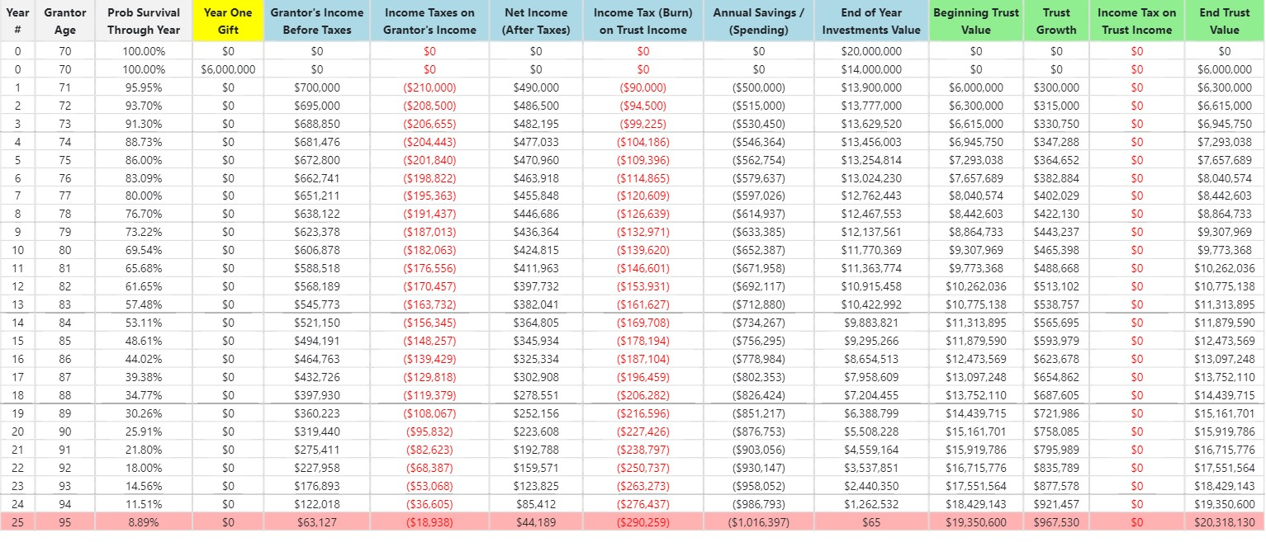
Illustrating the “Burn” – Scenario Two
Gift of $6,000,000, Leaving Senior with $14,000,000 to Age 95

Slide 16
Illustrating the “Burn” – Scenario Two
Gift of $6,000,000, Leaving Senior with $14,000,000 to Age 95

Slide 17
Illustrating the “Burn” – Scenario Two
Gift of $6,000,000, Leaving Senior with $14,000,000 to Age 95

Slide 18
Illustrating the “Burn” – Scenario Two
Gift of $6,000,000, Leaving Senior with $14,000,000 to Age 95
At age 95 Senior has $65 of assets remaining.
What if Senior lives past the age of 95?
The next example assumes that Senior lives to age 100 so that $14,000,000 of retained income producing assets is not enough.
Note that the probability of Senior living past age 95 is only 6.69%.

Slide 19
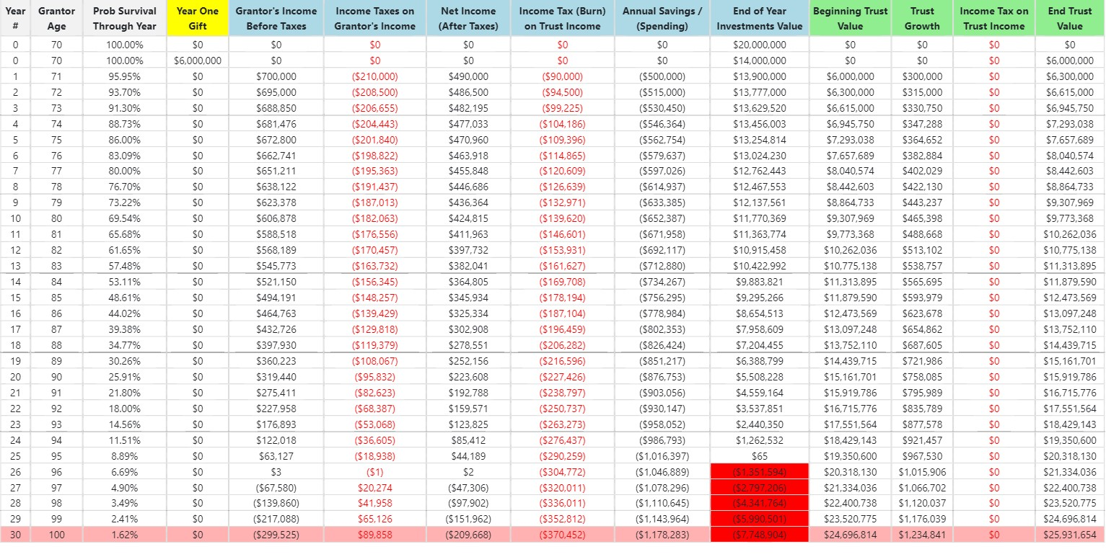
Illustrating the “Burn” – Scenario Three
Gift of $6,000,000 to Age 100

Slide 20
Illustrating the “Burn” – Scenario Three
Gift of $6,000,000 to Age 100

Slide 21
Illustrating the “Burn” – Scenario Three
Gift of $6,000,000 to Age 100

Slide 22
Illustrating the “Burn” – Scenario Three
Gift of $4,000,000 to Age 100
At age 96, Senior runs out of assets again.
The next example illustrates Senior gifts $4,000,000 of assets and retains $16,000,000. At age 100 Senior still has $894,981 of retained assets.
Now Senior feels financially comfortable.
If Senior’s investment assets were more than $20,000,000, say $30,000,000, then Senior can consider using the entire $13,610,000 gift tax exemption for 2024.

Slide 23

Illustrating the “Burn” – Scenario Three
Gift of $4,000,000, leaving Senior with $16,000,000 to Age 100

Slide 24
Illustrating the “Burn” – Scenario Three
Gift of $4,000,000, leaving Senior with $16,000,000 to Age 100

Slide 25
Illustrating the “Burn” – Scenario Three
Gift of $4,000,000, leaving Senior with $16,000,000 to Age 100

Slide 26
As the gift examples demonstrate, using financial spreadsheets allows the advisor to explain the planning technique using simple to follow numerical examples, achieving the first objective of communicating the estate tax benefits in an understandable manner
The second objective is to allow the advisor to change the assumptions so that the advisor and the client can both participate in the design of the planning proposal. Without the spreadsheets one would think that someone with $20,000,000 of income producing assets could take advantage to the 2024 $13,610,000 gift tax exemption by gifting $10,000,000 and retaining $10,000,000.
As the gifting examples demonstrate, by changing the assumptions using spreadsheets, the financial result the client feels comfortable with is only a $4,000,000 gift and retaining $16,000,000.
At the end of the materials, we provide a list of several alternatives that can be implemented when the estate plan is first implemented or afterwards while the grantor is living to reduce or eliminate the impact of the “burn.”

Slide 27
Illustrating the Financial Impacts of an Installment Sale to Grantor Trust
Assume the following facts:
Senior age 60 has $100,000,000 of income producing assets in a LLC, and needs $1,500,000 this year for personal consumption after social security and pension payments. Assume Senior’s living expenses increase at a 3% annual rate
Assume a 35% valuation discount applies to the LLC membership interests.
Senior gifts an 18.5% non-voting membership interest in the LLC with an $18,500,000 capital account to a Trust as a seed gift. Applying a valuation discount, the gift of an 18.5% interest uses $12,025,000 of Senior’s $13,610,000 gift tax exemption for 2024.
Senior sells a 57.5% non-voting membership interest with a $57,500,000 capital account to the Trust in exchange for a $37,375,000 (assumes a 35% discount applies) 20-year, interest only promissory note bearing interest at 4.18% ($1,562,000 annual interest).
Senior retains a 24% membership interest with a $24,000,000 capital account.
Assume a 6% investment rate of return and a 30% effective Federal and state income tax rate on capital gains and ordinary income.
The spreadsheet shows that the $37,375,000 note is paid at maturity in year 20.

Slide 28
LLC’s capital accounts after the gift in trust and the installment sale to the trust
The grantor retains a 24% interest with a $24,000,000 capital account and a $37,375,000 promissory note for a combined $61,375,000 of income producing assets
Capital Accounts | Capital Account Value |  | Discounted Value of non-voting membership interest
Senior (24% interest) | $24,000,000 |  | NA
Trust by gift (18.5% interest) | $18,500,000 |  | $12,025,000 (after discount)
Trust by purchase (57.5% interest ) | $57,500,000 |  | $37,375,000 (after discount)
Total | $100,000,000

Slide 29
In the first year the income on the $24,000,000 of retained partnership interest is $1,440,000. At a 30% income tax rate, the income taxes are $432,000. The grantor nets $1,008,000 after taxes.
The grantor receives $1,562,275 note interest that is not taxable interest income.
The grantor spends $1,500,000 on personal consumption.
The trust cannot deduct its interest expense.
The grantor must pay $1,368,000 of income taxes on the trust’s $4,560,000 of taxable income.
The grantor has to invade principal the first year as the revenues the grantor receives the first year are less than the expenses for the first year.
Personal consumption and the “burn” during the first year depletes retained assets by $297,725.
In the next year, with the depletion of the retained assets, the income on the retained assets is decreased.

Slide 30
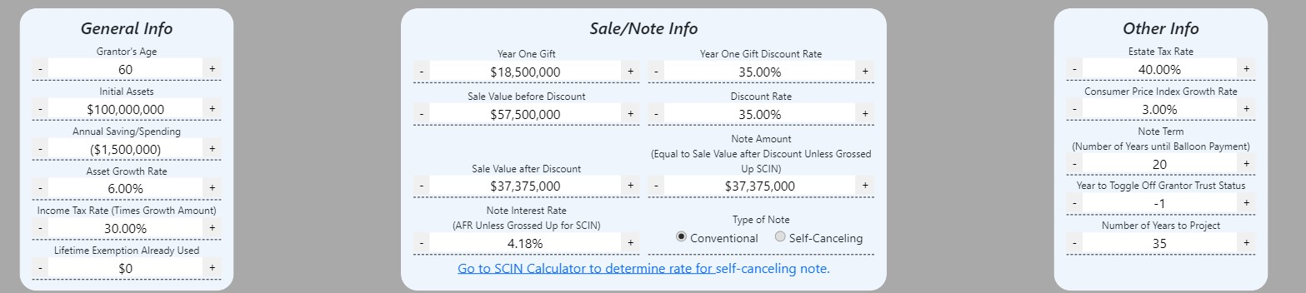
EstateView Inputs

Slide 33
What Can Be Done To Reduce The “Burn?”
Tax reimbursement clauses. May not be practical as cannot use it every year.
Terminate grantor trust treatment for the trust after the note is paid in full. Can have it automatically occurred by a clause in the trust agreement as the trustee may not be willing to terminate because of the duty of loyalty to only the beneficiaries. Or bifurcate grantor trust into a grantor trust and a non-grantor trust.
A larger interest rate on the note up to 5.0% above the AFR. See section 163(i). If increase the interest rate, the additional interest covers the SCIN risk premium.
Invest some of the trust’s assets in municipal bonds or assets that appreciate and that will not be sold while the grantor is living.
Invest trust assets in high cash value, low death benefit life insurance that does not produce taxable income.

Slide 34
What Can Be Done To Reduce The “Burn?”
Distribute some of the trust’s income producing assets to the beneficiaries.
Use a private annuity sale to continue payments to grantor for life.
Invest trust assets in encumbered real estate to shelter taxable income with depreciation losses, such as bonus depreciation.
If Senior were married could use a SLAT so that trust distributions can be made to the grantor’s spouse (viable only if the grantor’s spouse does not predecease the grantor).
Give the independent trustee the discretionary power to add the grantor as a beneficiary in a state like Nevada that has legislation that the grantor’s creditors cannot go after trust assets.
Prepay the note in whole or in part before maturity date.
12. Given that the discount is less significant than the burn, reduce the size of the valuation discount to say the 20% to 25 % that the IRS is more likely to accept and minimize the audit exposure.

Slide 35
What Can Be Done To Reduce The “Burn?”
Alternative One – Reduce the Discount Rate to 30%

Slide 36
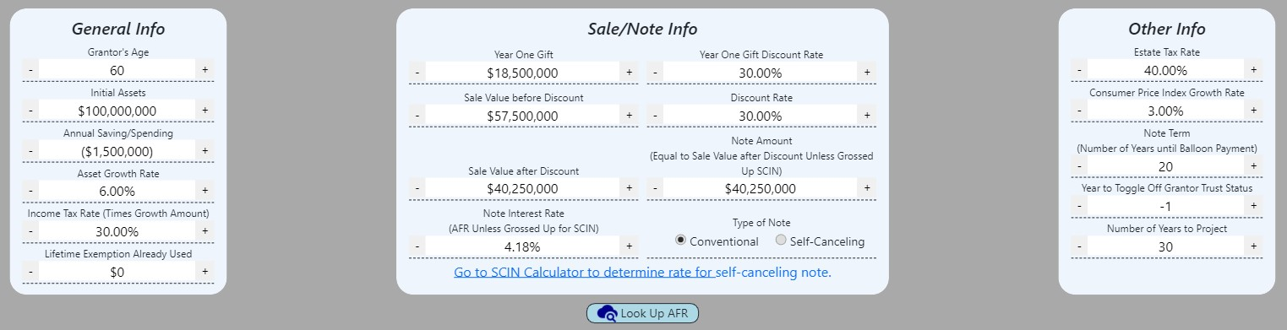

Slide 39
What Can Be Done To Reduce The “Burn?”
Alternative Two – Reduce the Discount Rate to 25%

Slide 40
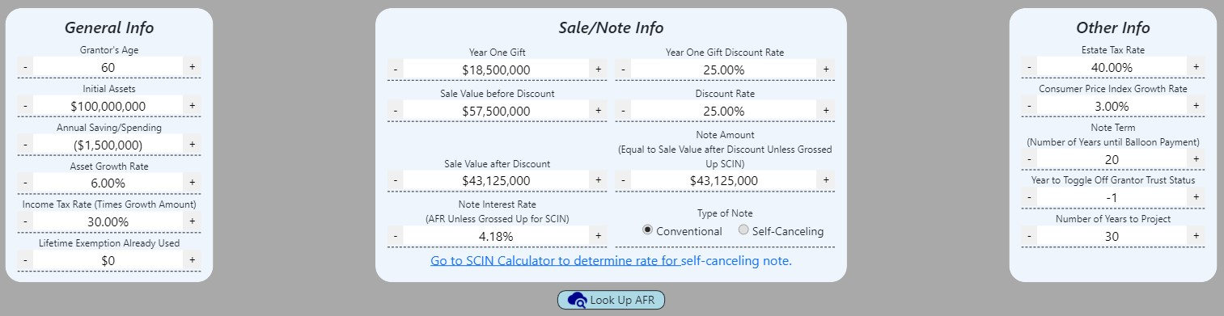

Slide 43
What Can Be Done To Reduce The “Burn?”
Alternative Three – Increase Interest Rate by 5% to 9.18%

Slide 44
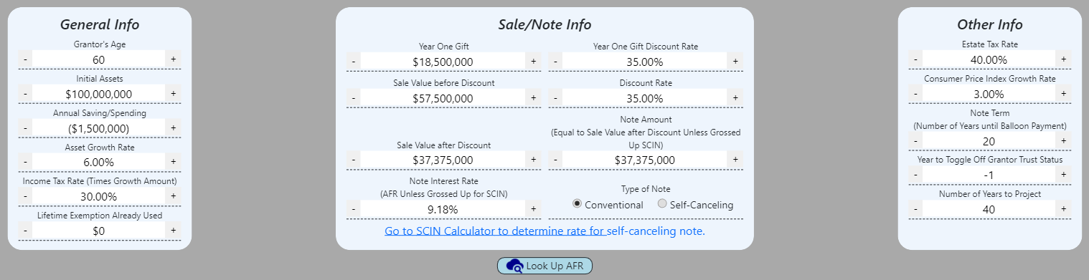

Slide 47
What Can Be Done To Reduce The “Burn?”
Alternative Four – Turn Off Grantor Trust Status in Year 20 After Note is Repaid

Slide 48
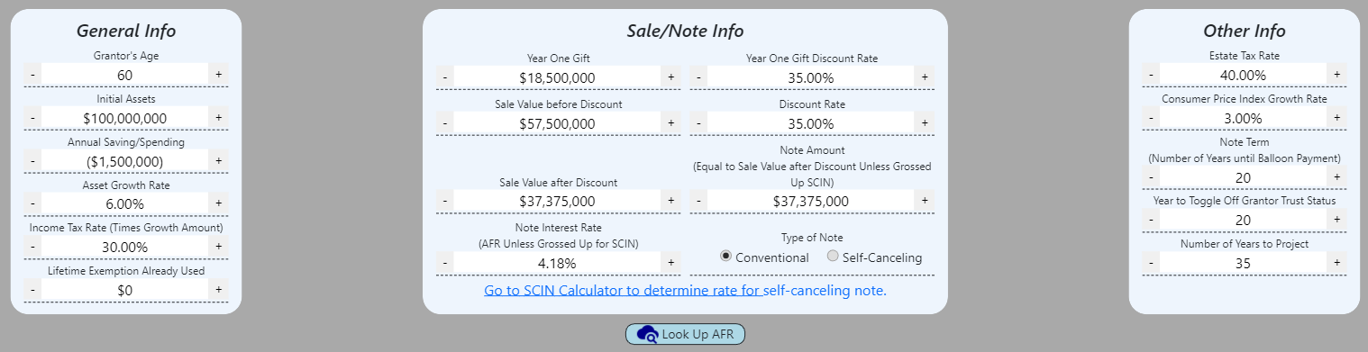

Slide 51
What Can Be Done To Reduce The “Burn?”
Alternative Five – Retain Additional Assets
$50,000,000 Retained

Slide 52
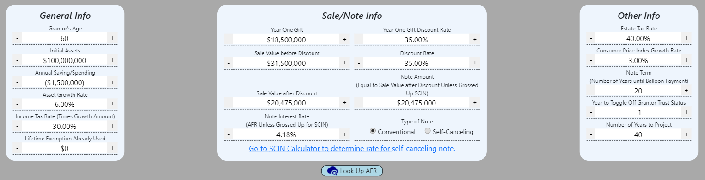

Slide 56


